Slide 1
Design of RF & Microwave Systems
EEC 134 A&B
Lecture 1: Introduction through a Brief History of Radios
Xiaoguang “Leo” Liu
Assistant Professor
School of Electrical and Computer Engineering
Tel: 530-289-6367
lxgliu@ucdavis.edu
http://ucdart.net

Slide 2
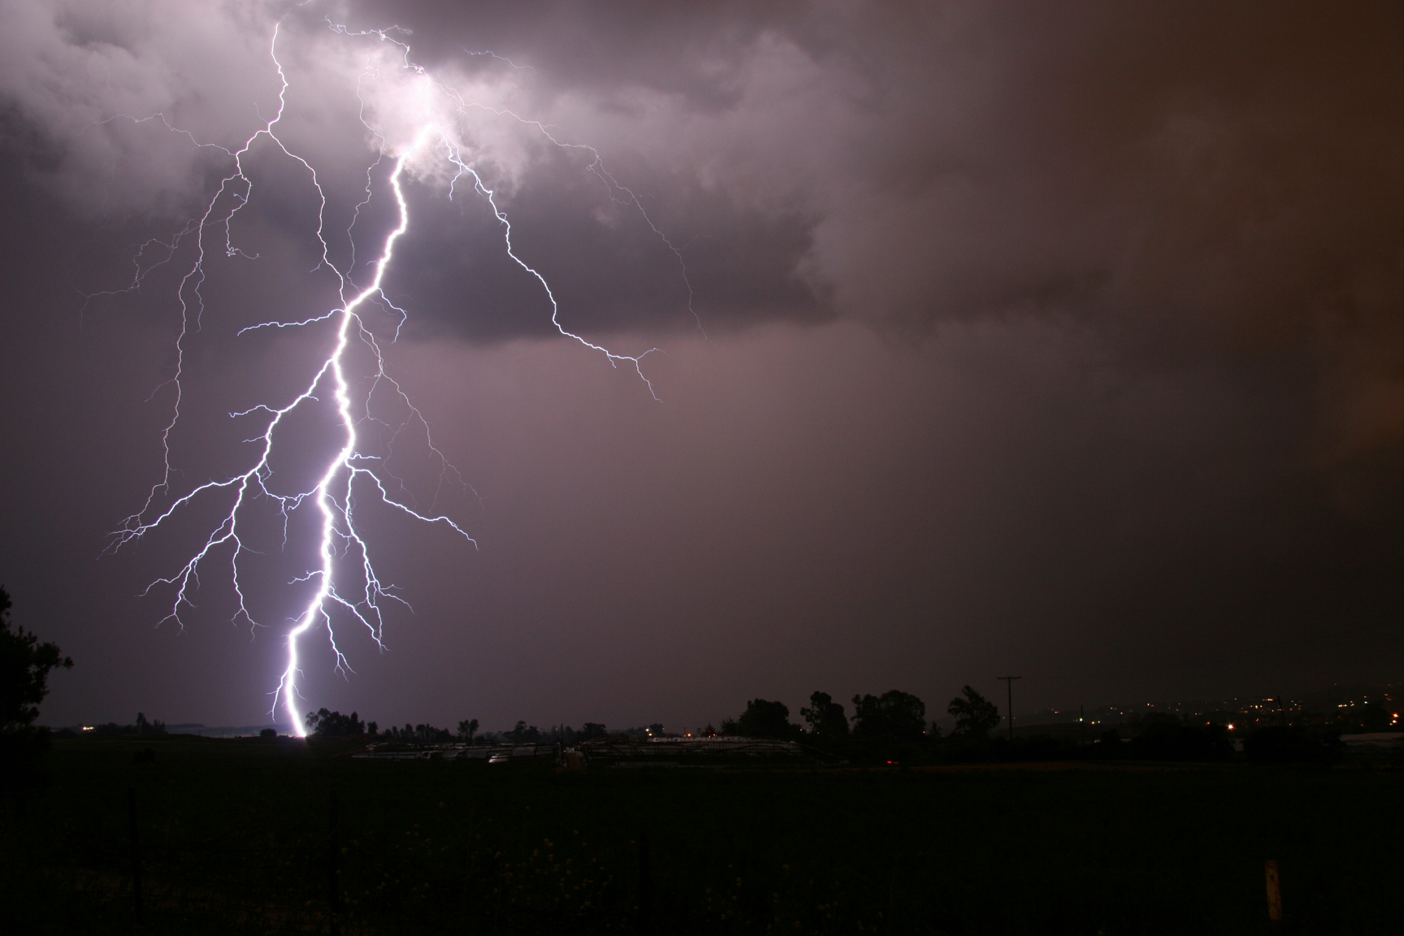
Electricity

Slide 3
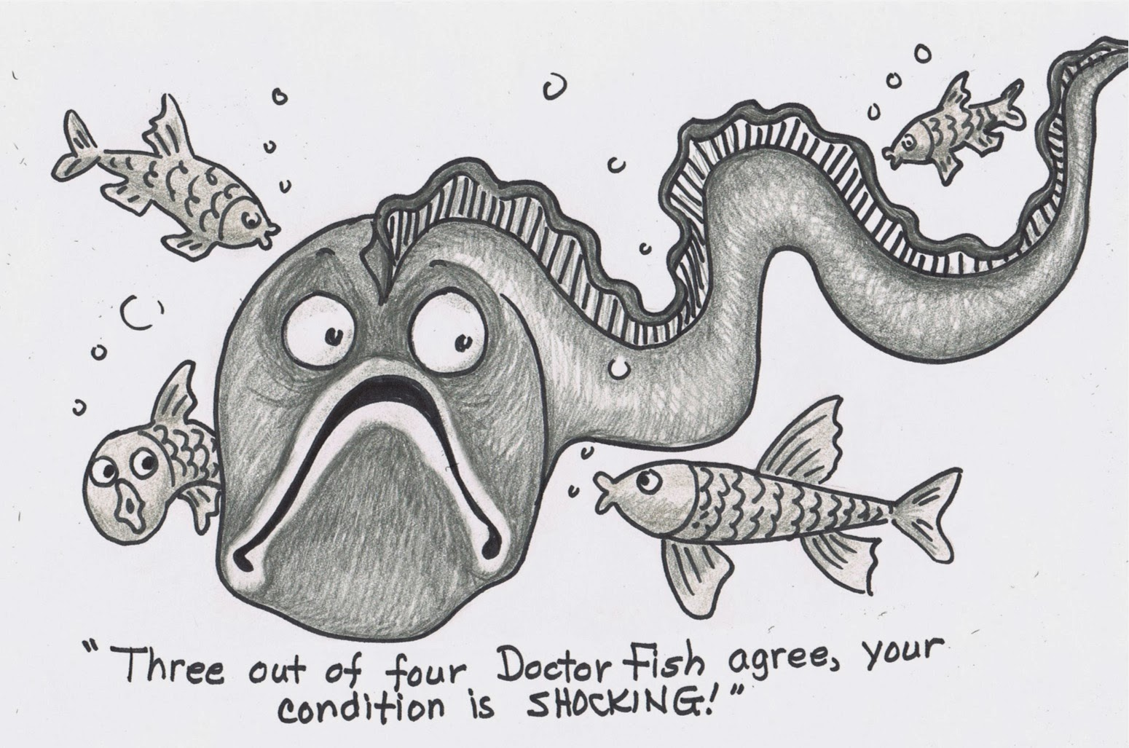
Electricity

Slide 4
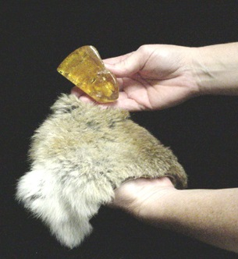
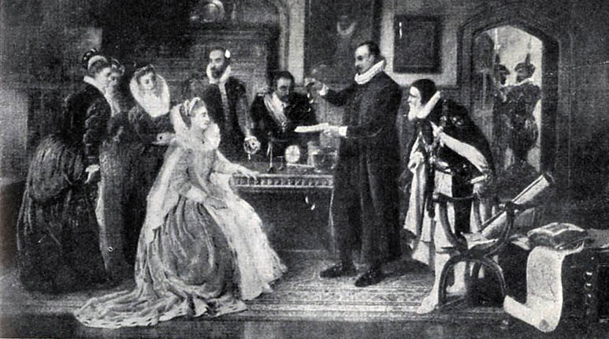
Electricity
1600, William Gilbert coined the word “electricus” to refer to the attraction of small objects to amber after it is rubbed; ἤλεκτρον (electron) is the Greek word for “amber”
“The electric effluvia differ much from air, and as air is the earth's effluvium, so electric bodies have their own distinctive effluvia; and each peculiar effluvium has its own individual power of leading to union, its own movement to its origin, to its fount, and to the body emitting the effluvium.”—De Magnete, English translation by Paul Fleury Mottelay, 1893
English words "electric" and "electricity" made their first appearance in print in Thomas Browne's Pseudodoxia Epidemica of 1646.
William Gilbert Demonstrating Electricity at Elizabeth I's Court
http://en.wikipedia.org/wiki/William_Gilbert_(astronomer)

Slide 5
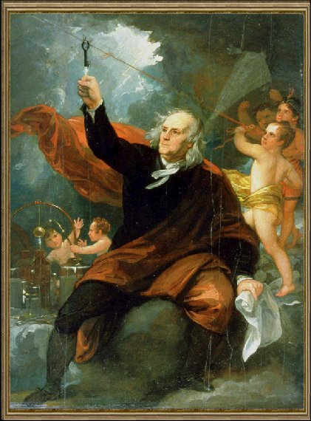
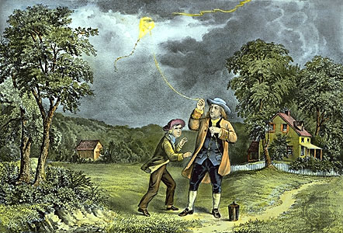
Electricity – Benjamin Franklin
Around 1750, Benjamin Franklin proposed that lightning is indeed electricity (electric discharge); he proposed an experiment to extract electricity from a lightning.
Evidence seems to show that he indeed carried out these experiments with proper insulation.
Benjamin also proposed the distinction between positive and negative charges.
Notes:
Franklin’s Kite Experiment: https://www.youtube.com/watch?v=YcNs8Yn6Cjk

Slide 6
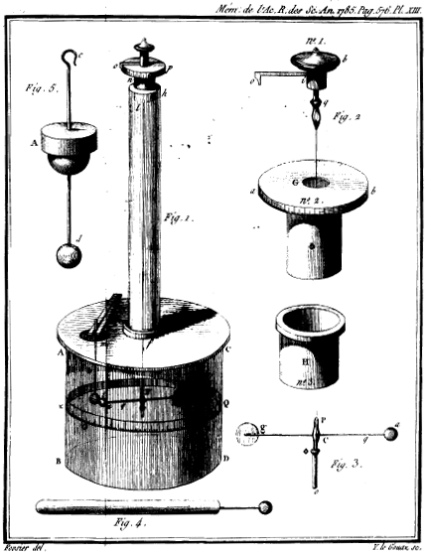
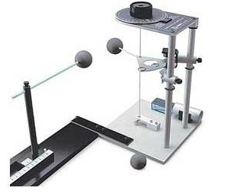
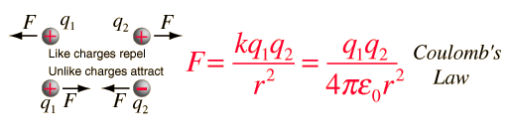
Electricity – Charles-Augustin de Coulomb
Around 1784, Coulomb measured the forces of attraction and repulsion between electric charges and magnetic poles
He concluded that the attractive force between two oppositely charged spheres is proportional to the product of the quantities of charge on the spheres and is inversely proportional to the square of the distance between the spheres

Slide 7
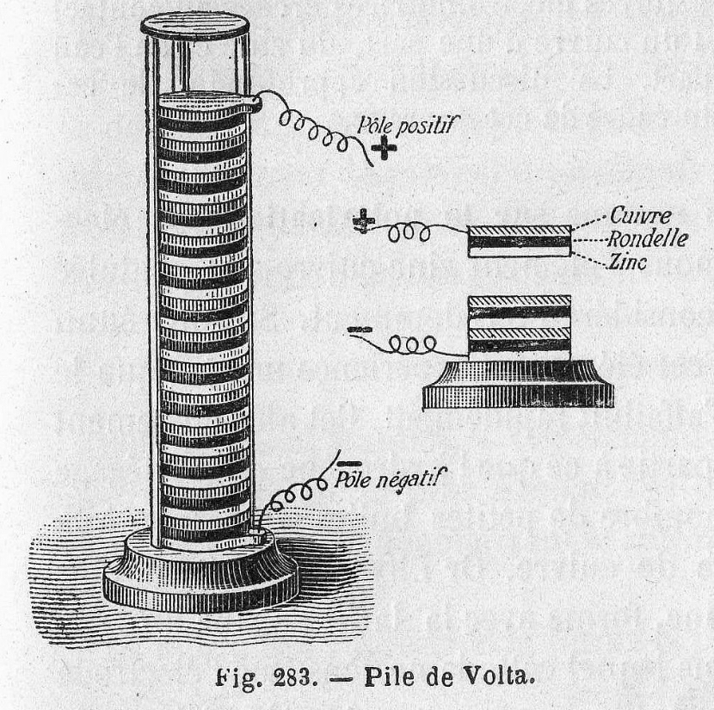
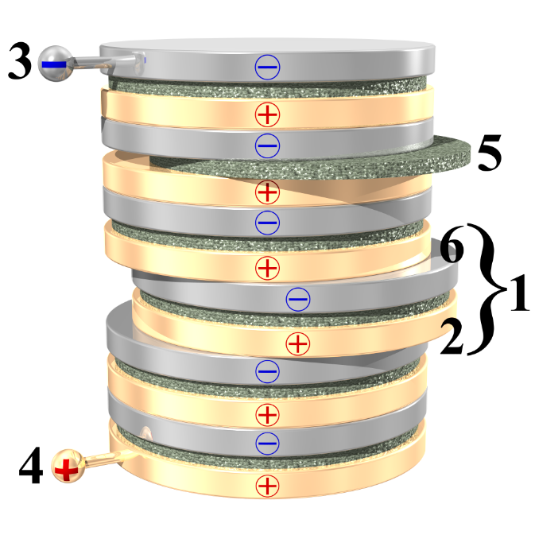
Electricity – Alessandro Volta
In 1800, Alessandro Volta invented the voltaic pile, which for the first time provided a reliable source of electricity
The SI unit for electric potential (voltage) is named after him: volt (V)
Volta was the first to realize the relationship between the electric potential and the amount of charge an object can hold, giving rise to the concept of capacitance

Slide 8
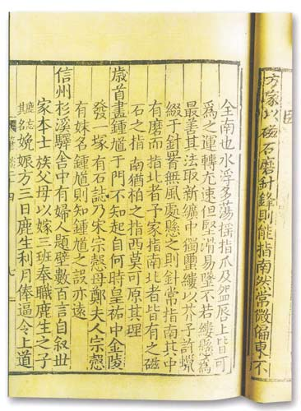
Magnetism
Magnetic phenomenas have been known to human kind for a long time
Many accounts from ancient Greece, India, and China, dating back to 600 BC.
Around AD 50, Chinese literature documented the attraction of a needle by a lodestone
Around AD 1000, methods of making a compass for navigation was documented by Chinese
Notes:
北宋时，曾公亮在《武经总要》载有制作和使用指南鱼的的方法：“用薄铁叶剪裁，长二寸，阔五分，首尾锐如鱼型，置炭火中烧之，侯通赤，以铁钤钤鱼首出火，以尾正对子位，蘸水盆中，没尾数分则止，以密器收之。用时，置水碗于无风处平放，鱼在水面，令浮，其首常向午也。”这是一种人工磁化的方法，它利用地球磁场使铁片磁化。即把烧红的铁片放置在子午线的方向上。烧红的铁片内部分子处于比较活动的状态，使铁分子顺着地球磁场方向排列，达到磁化的目的。蘸入水中，可把这种排列较快地固定下来，而鱼尾略向下倾斜可增大磁化程度。人工磁化方法的发明，对指南针的应用和发展起了巨大的作用。在磁学和地磁学的发展史上也是一件大事。北宋的沈括在《梦溪笔谈》中提到另一种人工磁化的方法：“方家以磁石摩针锋，则能指南。”按沈括的说法，当时的技术人员用磁石去摩擦缝衣针，就能使针带上磁性。从现在的观点来看，这是一种利用天然磁石的磁场作用，使钢针内部磁畴的排列趋于某一方向，从而使钢针显示出磁性的方法。这种方法比地磁法简单，而且磁化效果比地磁法好，摩擦法的发明不但世界最早，而且为有实用价值的磁指向器的出现，创造了条件。

Slide 9
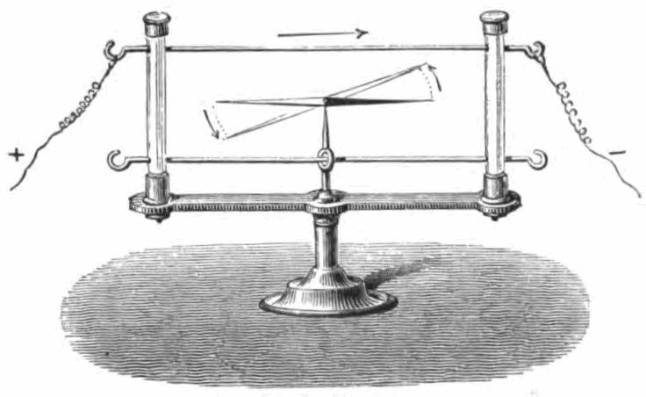
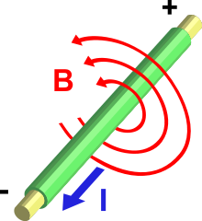
Electromagnetism
In 1820, Hans Christian Ørsted discovered that a compass needle could turn its direction from north when an electric current is turn on nearby
André-Marie Ampère further showed that showed that two parallel wires carrying electric currents attract or repel each other, depending on whether the currents flow in the same or opposite directions, respectively
Ampère also formulated the mathematics explaining the physics of electromagnetism

Slide 10
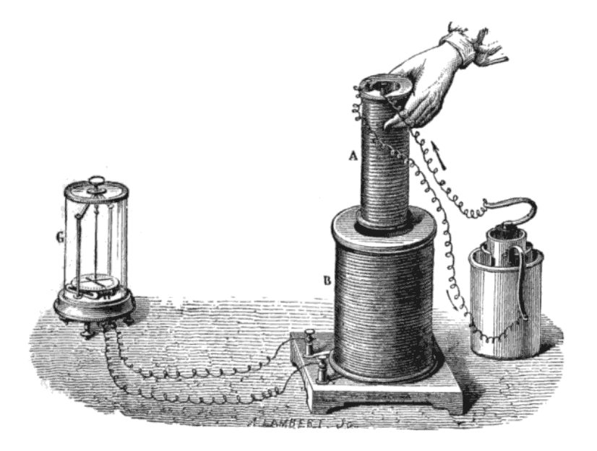
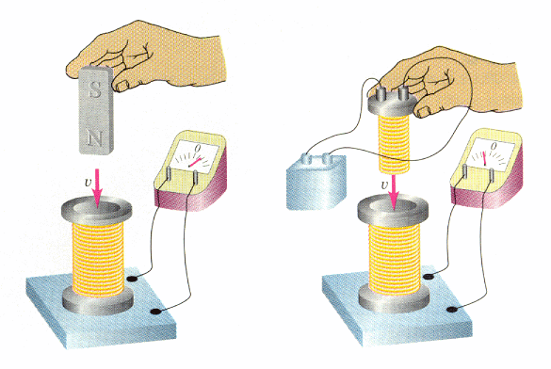
Electromagnetic Induction
Around 1831, Michael Faraday experimentally demonstrated that a moving magnet can induce electric voltage
This gives a big clue about the unification of electricity and magnetism
This also lead to the invention of electric generator
Faraday also demonstrated mutual induction, electric motor, and proposed the concept of electromagnetic “field” --- an interaction that extends beyond physical contact

Slide 11
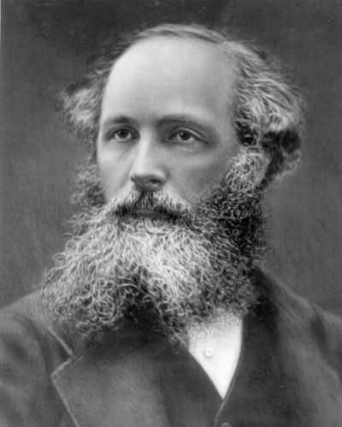
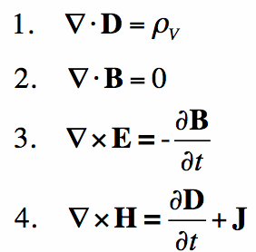
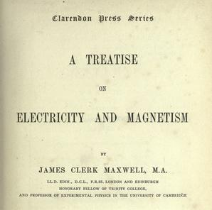
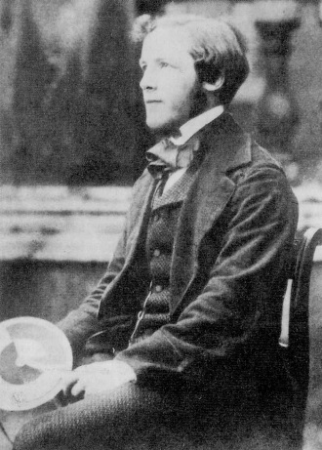
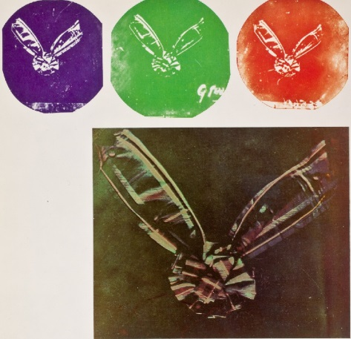
James Clerk Maxwell
The Maxwell’s Equations
Introduced the concept of “displacement current
Unified electric and magnetic theory
Predicted the electromagnetic wave
Also invented color photography and pioneered modern control theory

Slide 12
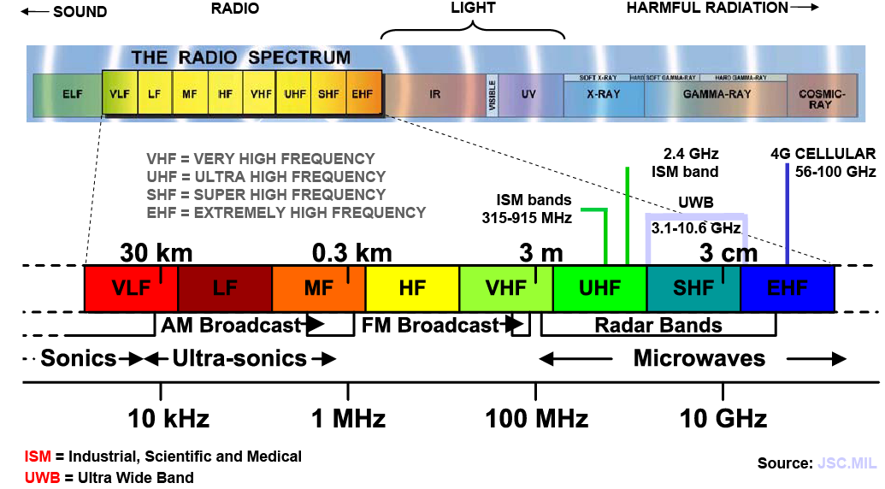
Electromagnetic Spectrum

Slide 13
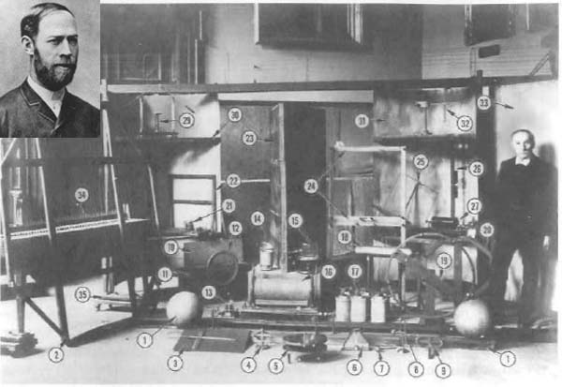
Heinrich Rudolf Hertz
Experimentally verified Maxwell’s theory of electromagnetic waves
By building a radio transmitter and receiver
Original Apparatus used by Heinrich Rudolf Hertz (February 22, 1857 – January 1, 1894) for his experiments to prove the existence of electromagnetic waves.
http://mouloudrahmani.com/electrical/rfmicrowave/RFMicrowaveHome.html

Slide 14
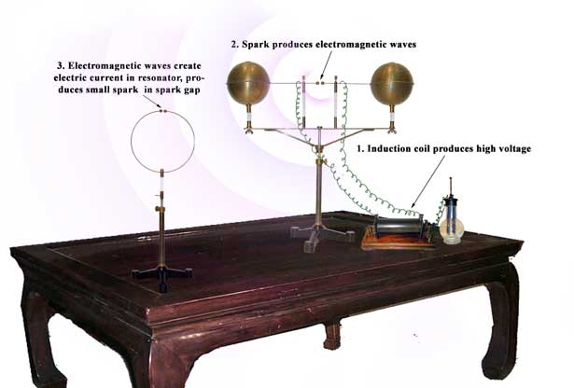
Hertz’s Experiment Set-up
Spark transmitter and receiver
Use high voltage to induce sparks between two closely placed electrodes
The sparks give off radio waves of a wide range of frequencies
Hertz’s experiment requires very high power to ignite the spark in the receiver
http://www.sparkmuseum.com/BOOK_HERTZ.HTM

Slide 15
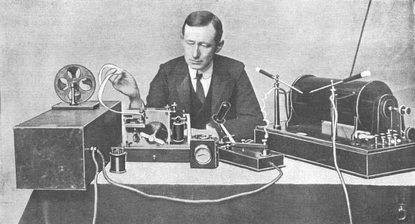
Guglielmo Marconi
Realized the potential of using radio waves for long range wireless communication
A very successful businessman
http://en.wikipedia.org/wiki/File:Marconi_at_desk.jpg

Slide 16
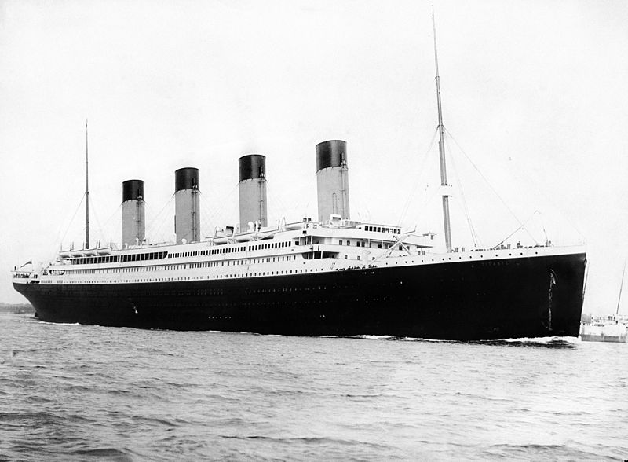
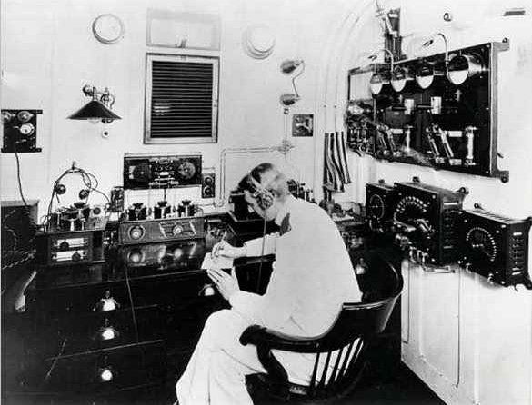
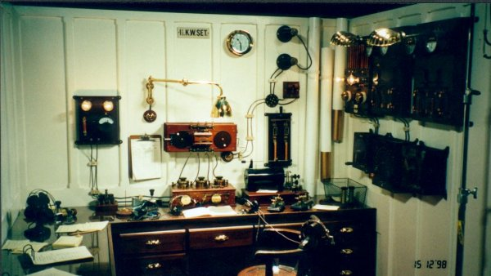
The Titanic
12:40 am, 15 April 1912 R.M.S. Titanic to R.M.S. Carpathia: "SOS Titanic sinking by the head. We are about all down. Sinking. . ."
http://www.hf.ro/

Slide 17
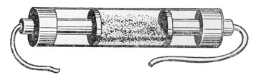
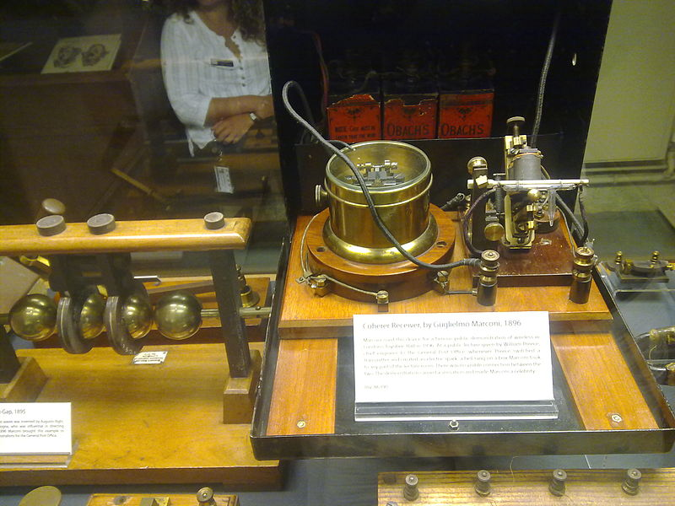
The Coherer
The invention of the coherer allows weak signals to be detected
The coherer consists of a tube filled by metal filings, and two electrodes contacting the metal filings
Radio waves causes the conductivity between the electrodes to decrease
Unfortunately, it only works once!
The exact working principles of coherer is still not known
The radioconductor or coherer was invented in 1890 by the French physicist Edouard Branly
Marconi's 1896 coherer receiver, at the Oxford Museum of the History of Science, UK. The coherer is on right, with the decoherer mechanism behind it. The relay is in the cylindrical metal container (center) to shield the coherer from the RF noise from its contacts.
http://www.historywebsite.co.uk/Museum/Engineering/Electronics/history/earlytxrx.htm
http://en.wikipedia.org/wiki/Coherer
Notes:
Simple Homemade Coherer: http://www.sparkbangbuzz.com/els/coherer-el.htm
Coherer(Wikipedia): http://en.wikipedia.org/wiki/Coherer

Slide 18
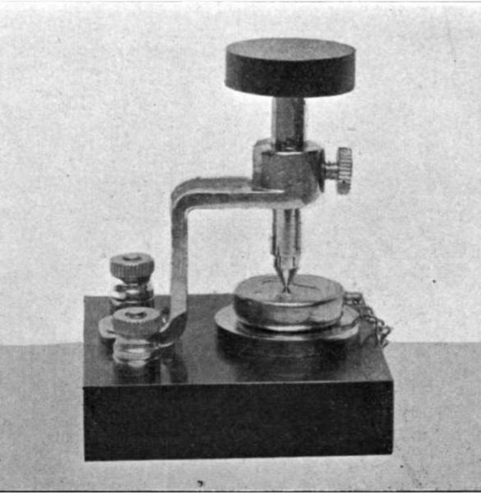
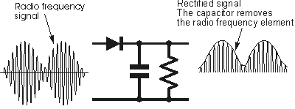
Crystal Receiver
Also known as “crystal set” or “cat’s whisker detector”
Relies on the rectifying contact between metal and certain crystalline minerals, such as galena; today we know this as a diode
Very simple and inexpensive to construct: antenna wire, tuning coil, capacitor, a crystal, and earphones
No batteries needed
It’s a passive detector; meaning it doesn’t require external power
Also means that there is no amplification of the signal
Range is rather limited; or else you’d have send tons of power at the transmitter
Greenleaf Pickard’s silicon crystal receiver
http://commons.wikimedia.org/wiki/File:Silicon_crystal_detector.jpg

Slide 19
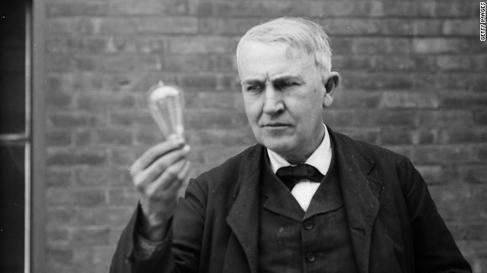
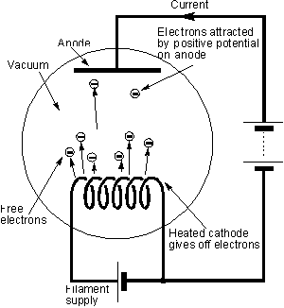
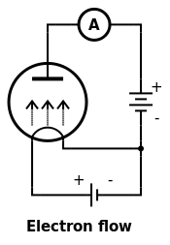
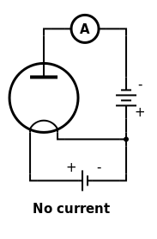
The Edison Effect
Thomas Edison discovered that if you insert a piece of wire into the light bulb and give it a potential, some current will be flowing but only when the second electrode is given a positive voltage with respect to the filament.
This was actually a rediscovery of a phenomenon described by Frederick Guthrie in 1873
http://licn.typepad.com/my_weblog/2012/07/the-almosts-john-dunn-consultant-ambertec-pe-pc.html
http://www.cnn.com/2011/12/31/opinion/sloane-edison-bulbs/

Slide 20
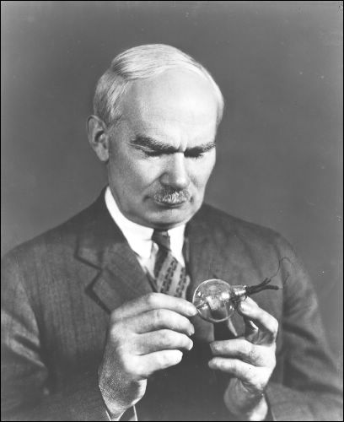
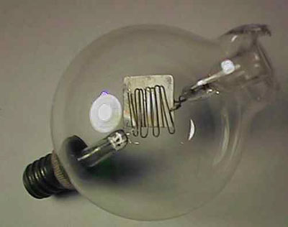
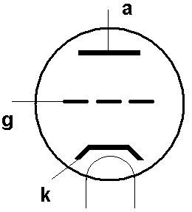
The Audion
In 1907, Lee de Forest invented the “audion”, the first vacuum tube device
The device was based on a phenomena observed by Thomas Edison:
when a correct polarity of voltage is applied between the hot filament and an electrode inside a light bulb, a current can be measured; this is now known as “thermionic emission”
De Forest added another plate inside the bulb and was able to use it to control the current flow
De Forest invented by tinkering and it was apparent he didn’t understand how the device actually worked!
De Forest coined the term “radio”; he didn’t like “wireless”…
http://en.wikipedia.org/wiki/Lee_de_Forest
http://uv201.com/Tube_Pages/deforest_audion.htm
http://earlyradiohistory.us/1907aud.htm
http://historysanjose.org/wp/research-collection/collections/the-perham-collection/the-people/lee-de-forest/

Slide 21
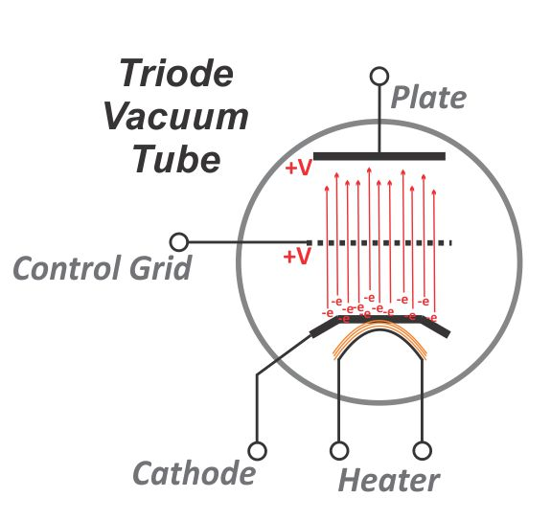
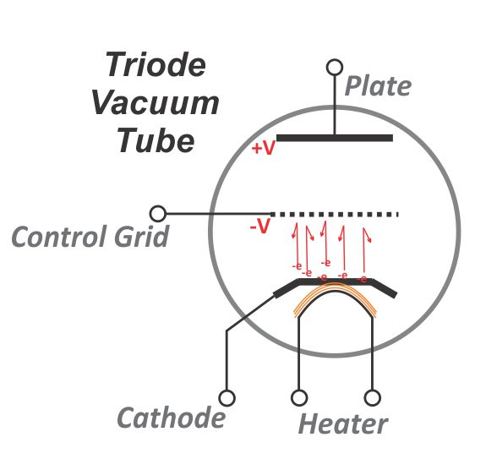
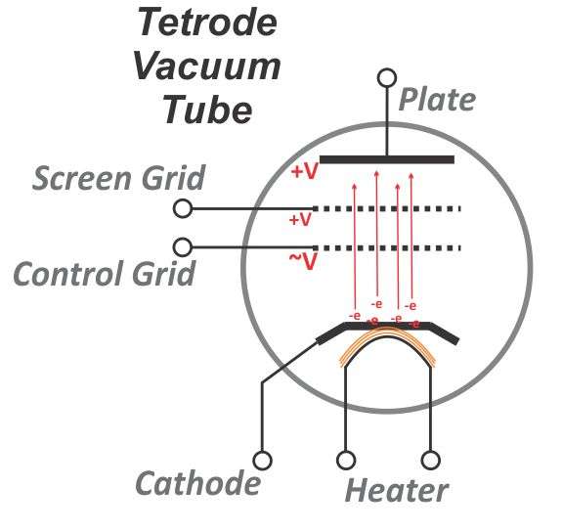
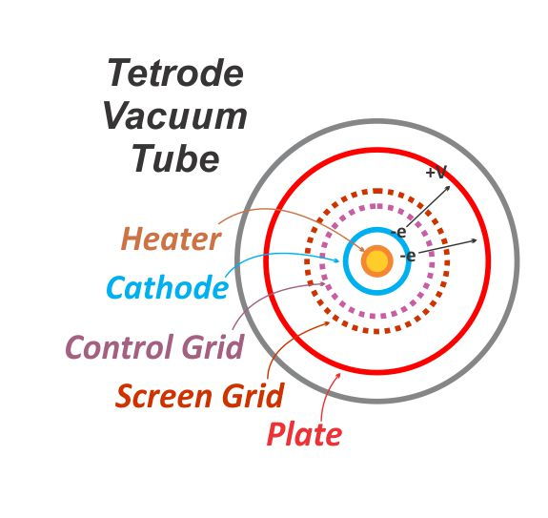
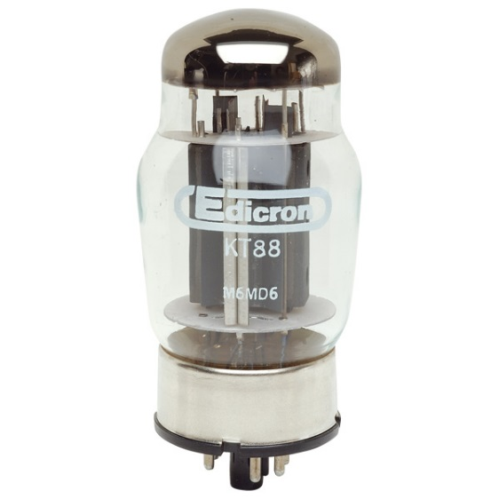
The Audion – The Triode and the Tetrode
Allows a weak voltage signal to control a stronger current → signal amplification
http://www.hamradioschool.com/g6b10-vacuum-tubes/
http://www.rapidonline.com/electronic-components/kt88-tetrode-valve-35365
Notes:
Schematic of the triode; show some amplifier circuits; explain why gain is low

Slide 22
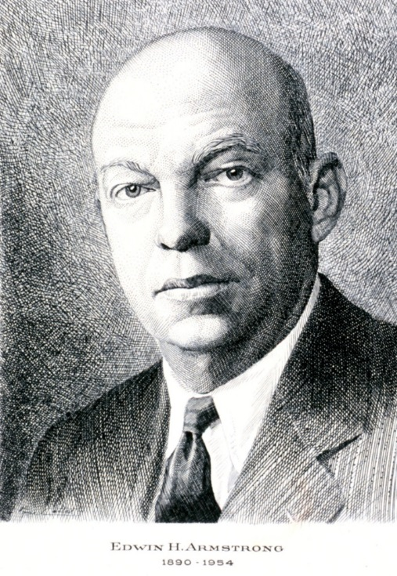
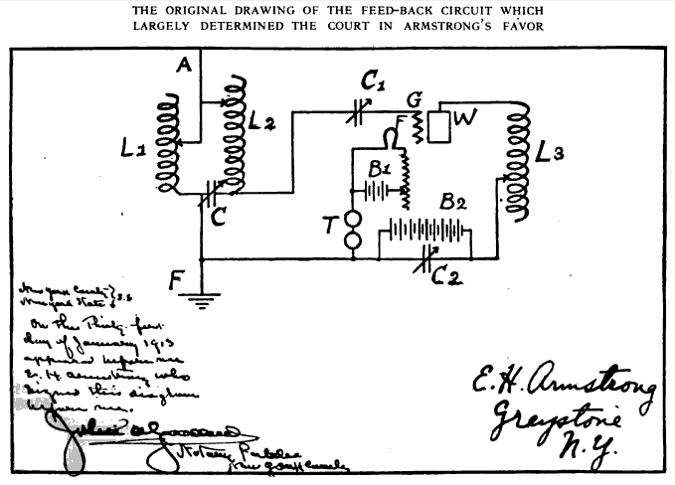
Edwin Howard Armstrong
The audion was initially used as a diode in a receiver; it was very popular and essentially replaced the coherers and crystal radios
The use of audion to amplify signals was invented by Edwin Howard Armstrong, a name that you should remember if you major in RF/microwave engineering; he essentially invented most of the high frequency techniques we use today.
The original drawing of Edwin Armstrong’s “regenerative” circuit
http://en.wikipedia.org/wiki/Edwin_Armstrong

Slide 23
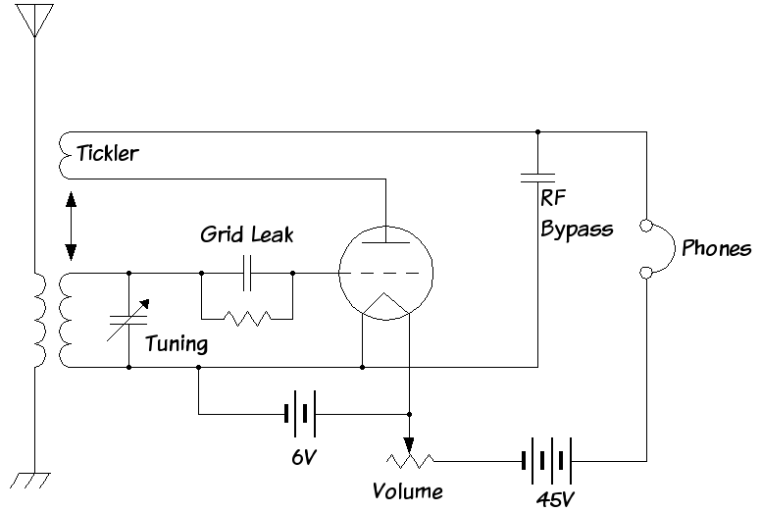
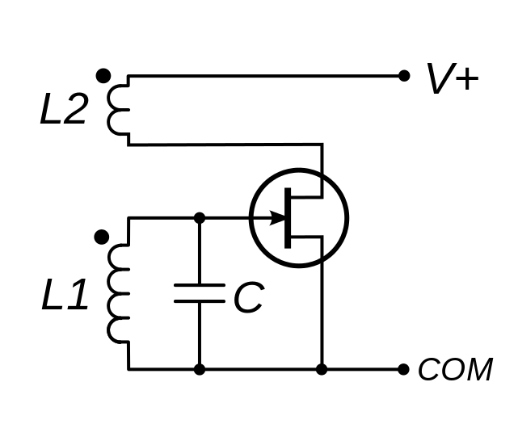
Edwin Howard Armstrong
Born in 1890; became interested in radio technologies at an early age
Invented regeneration (amplification by positive feedback) while in college
At the same time, he also observed high frequency oscillation of the signals if the feedback is made stronger; thus inventing an oscillator which could be used to generate strong signals for radio transmitters
These two inventions paved way for continuous wave (CW) radio communications, which very soon took over “spark”-based radios
Feedback
http://en.wikipedia.org/wiki/Armstrong_oscillator
http://en.wikipedia.org/wiki/Regenerative_circuit

Slide 24
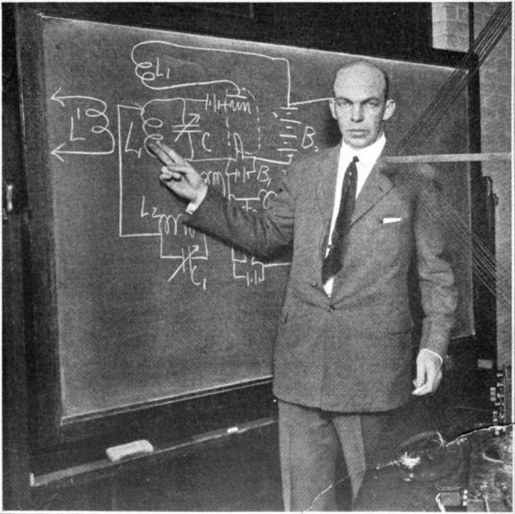
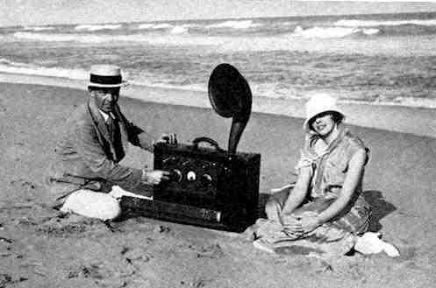
Edwin Howard Armstrong
Armstrong joined both WWs, and allowed the US Military to use his patents for free
In 1918, during WW-I, he invented the superheterodyne receiver; which is still used in most of today’s radios
In 1922, he invented the super-regenerative receiver, which today finds applications in simple low-cost radio remote controls
In 1935, he invented the frequency modulation (FM) radio
Armstrong made profound contributions to radio technologies; but he was not a successful businessman
Committed suicide in 1954
Armstrong explaining the super-regenerative receiver, New York, 1922
Armstrong and his new wife Esther Marion MacInnis in 1923. The radio is a portable superheterodyne that Armstrong built as a present for her.
http://en.wikipedia.org/wiki/Edwin_Howard_Armstrong

Slide 25

Superheterodyne Receiver – Heterodyne
Let’s start with “heterodyne”
“Heterodyning is a radio signal processing technique popularized by Canadian inventor-engineer Reginald Fessenden in 1901, in which new frequencies are created by combining or mixing two frequencies.”
“The two frequencies are combined in a nonlinear signal-processing device such as a vacuum tube, transistor, or diode, usually called a mixer. In the most common application, two signals at frequencies f₁ and f₂ are mixed, creating two new signals, one at the sum f₁ + f₂ of the two frequencies, and the other at the difference f₁ − f₂. These new frequencies are called heterodynes. Typically only one of the new frequencies is desired, and the other signal is filtered out of the output of the mixer.”
f₁ + f₂
f₁
f₁ − f₂
f₂

Slide 26

Superheterodyne Receiver
Move the incoming RF signal to a much lower frequency for detection
It is easier to build detectors at lower frequencies
It is easier have gain at lower frequencies
Gain can also be distributed across different frequencies to avoid oscillation
Great performance

Slide 27

Superheterodyne Receiver
Block diagram with a more modern look
Principles are still the same
http://mwrf.com/components/quad-demodulators-arm-direct-conversion-receivers

Slide 28

Homodyne (Direct Conversion) Receiver
There is no IF, move the RF signal to base-band directly
A very flexible architecture
There are number of technical issues initially; was not very popular for a longtime
Recently development in integrated circuit technologies has largely revived this architecture

Slide 29

RADAR – RAdio Detection And Ranging
Hertz was aware that electromagnetic waves can bounce off solid objects.
In 1900 Nikola Tesla (1856-1943), a Serbian-American inventor obviously aware of this technique, conceived of the possibility of employing radio waves not only to detect, but also to measure the movement of distant objects, although he never worked out the details of his idea.
Patents on using radio waves to detect the presence of distant metallic objects were filed by German inventor Christian Hulsmeyer circa 1904 in Germany and Great Britain.
http://www.geos.ed.ac.uk/homes/ihw/timeline.html

Slide 30


The Magnetron
The invention of the magnetron by John Randall and Harry Boot in 1940 at the University of Birmingham, England, made it possible to generate very high power coherent radiation at microwave frequencies
This finally made radar technologies practical for warfare
http://hyperphysics.phy-astr.gsu.edu/hbase/waves/magnetron.html
http://microwavetubes.iwarp.com/How_Magnetron_Work.html

Slide 31


RADAR
Several nations started research on radar technologies before WWII; the term RADAR was coined by US Navy in 1940
Military use was the main driving force for radar development
British: Chain Home radars
Germany: mid-war ground radar station FuMO 214 Würzburg-Riese
Deflating British Radar Myths of World War II
http://spitfiresite.com/2010/04/deflating-british-radar-myths-of-world-war-ii.html/6

Slide 32

Proximity Fuse
Radio proximity fuse developed by the Applied Physics Laboratory during WWII
Arguably the simplest radar
Further reading: http://www.history.navy.mil/faqs/faq96-1.htm
http://www.jhuapl.edu/aboutapl/heritage/fuze/default.asp

Slide 33

Microwave Ovens
Invented by Percy L. Spencer, vice president of Raytheon, in 1945

Slide 34


Microwave Ovens
The first microwave ovens were called “Radarange”…
Weighted 750 lbs
Not a commercial success until the 60s, when they became much smaller with the invention of a new generation of magnetron sources
http://www.marketingvp.com/guests/globe/oven.htm
http://www.smecc.org/microwave_oven.htm

Slide 35




The Transistor
In 1947, William Shockley (seated), John Bardeen (center), and Walter Brattain (right) invented the transistor
This probably advanced the pace of human civilization by a few orders of magnitude
They went on to win the Nobel Prize in 1956
The first transistor as it was patented
http://www.zdnet.com/blog/computers/why-intels-22nm-technology-really-matters/5703
http://en.wikipedia.org/wiki/Transistor

Slide 36


The Transistor
A small signal controls a larger signal, without the use of vacuum
C
B
E

Slide 37


Integrated Circuits
Jack Kilby, 1958
How many transistors?
Intel i7 3.4 GHz, 2012
How many transistors?

Slide 38


Vacuum Tube vs. Transistor
8.47 x 10.50 mm
ENIAC
18,000 vacuum tubes
0.1 MHz
Intel Xeon E5-2600 V3
5,500,000,000 transistors
~1.4 GHz/core
http://wccftech.com/intel-xeon-e52600-v3-haswellep-workstation-server-processors-unleashed-highperformance-computing/1

Slide 39


RF/Microwave Integrated Circuits
In a similar way as you put digital logic into the form of an IC, RF and microwave circuits can also be integrated
Both silicon and more exotic materials are used
GaAs, mature, high frequencies
GaN, emerging, high power
InP, maturing, extremely high freq.
Silicon, mature, low/high power, low cost, high freq.

Slide 40



Radio Frequency Integrated Circuits
Today’s silicon IC technologies are extremely fast
Consider, your Intel i7s are running at a clock rate of close to 4 GHz; that’s higher than the RF carrier frequency of your cellphones; also higher than the high power microwaves in a microwave oven
65nm CMOS transistor can now generate frequencies up to 300 GHz (over 1,000 GHz if harmonics are used)
Today’s silicon ICs also have extremely high density
You can now implement entire RF/microwave systems on a single chip of tiny area
The availability of vast amount of digital circuits makes it possible to realize new circuit/system architectures a

Slide 41


RF System on Chip
Complete wireless communication transceiver on a single chip
Complete radar system on a single chip, even with the antenna

Slide 42




Realization of RF/Microwave Systems
PCBs with Integrated Circuits (IC)
RF IC suppliers
Skyworks
Analog Devices
RFMD
Freescale
Triquent
Hittite Microwave
…
Skyworks
Analog Devices
http://www.microwavejournal.com/articles/8334-two-stage-ultra-low-noise-amplifiers

Slide 43


Realization of RF/Microwave Systems
RF/microwave PCBs
With discrete transistors

Slide 44



So are Vacuum Tubes Dead?
Vacuum tubes and waveguides
AN/FPS-50 Detection Radar

Slide 45


Wireless Communication
4.5 million cell phones sold every day
7 trillion text messages sent in 2011
1987
2014

Slide 46





Communication
TV and radio broadcast
Wireless cellular networks
Microwave point-to-point links
Walkie-talkies
Images taken from the Internet

Slide 47

Communication System
Receive
Transmit
Image taken from Analog Device Website

Slide 48

Radar
Transmit
Receive
Read more: http://mil-aero.analog.com/en/radar/segment/ma.html

Slide 49




Radio Astronomy
See the universe in radio waves (vs. visible light)
Map of the Cosmic Microwave Background (CMB) at 160.2 GHz
Credit: NASA
Very Large Array (VLA)
radio telescope

Slide 50




RF/Microwave Test Equipment
Vector Network Analyzer
Spectrum Analyzer

